Slide 1


Annual Review
ROCKBUSTER STEALTH INC.
February 24, 2023
BABAFEMI OLAYINKA

Slide 2

Agenda
Introduction
Project Objectives And Goals
Company Overview
Visuals
Recommendation

Slide 3

Introduction
Rockbuster Stealth LLC is a movie rental company that used to have stores around the world. Facing stiff competition from streaming services such as Netflix and Amazon Prime, the
Rockbuster Stealth management team is planning to use its existing movie licenses to launch an online video rental service in order to stay competitive.

Slide 4

Top selling films Lowest selling films Top selling genres Lowest selling genres Rental Duration Top Countries for Sales
GOALS
Let’s dive in

Slide 5
Which movies contributed the most/least to revenue gain?

Slide 6
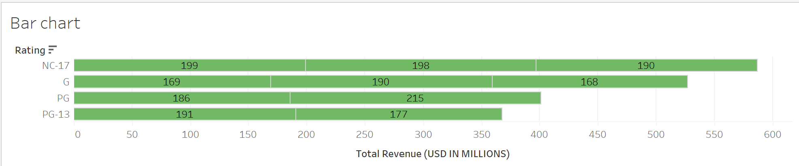
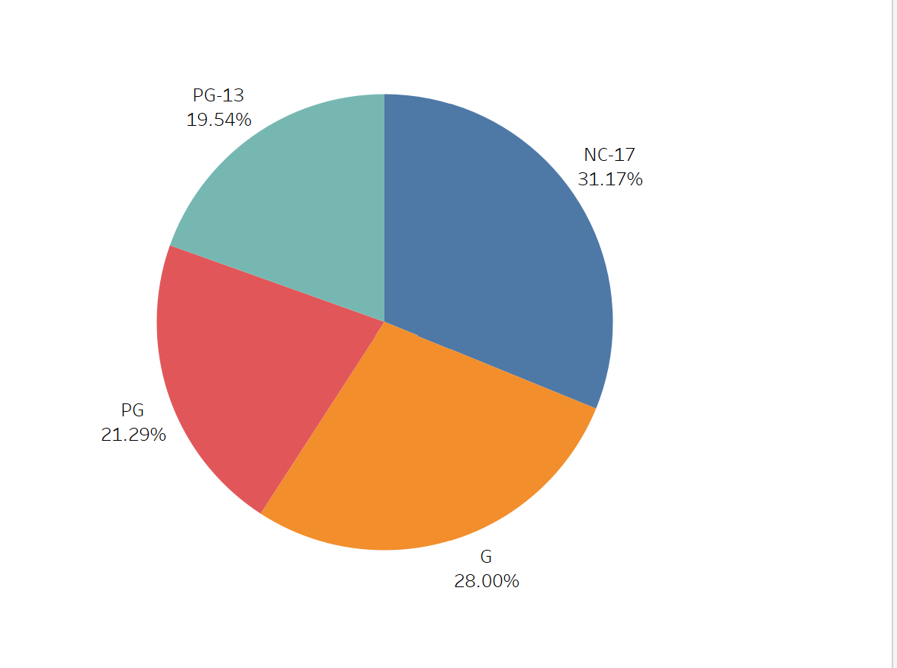
Percentage distribution of Revenue By Rating
This graph represents the total revenue from each rating. From this we can see that’s rating NC-17 as the highest revenue rating by far, and PG-13 rating as the lowest revenue.

Slide 7
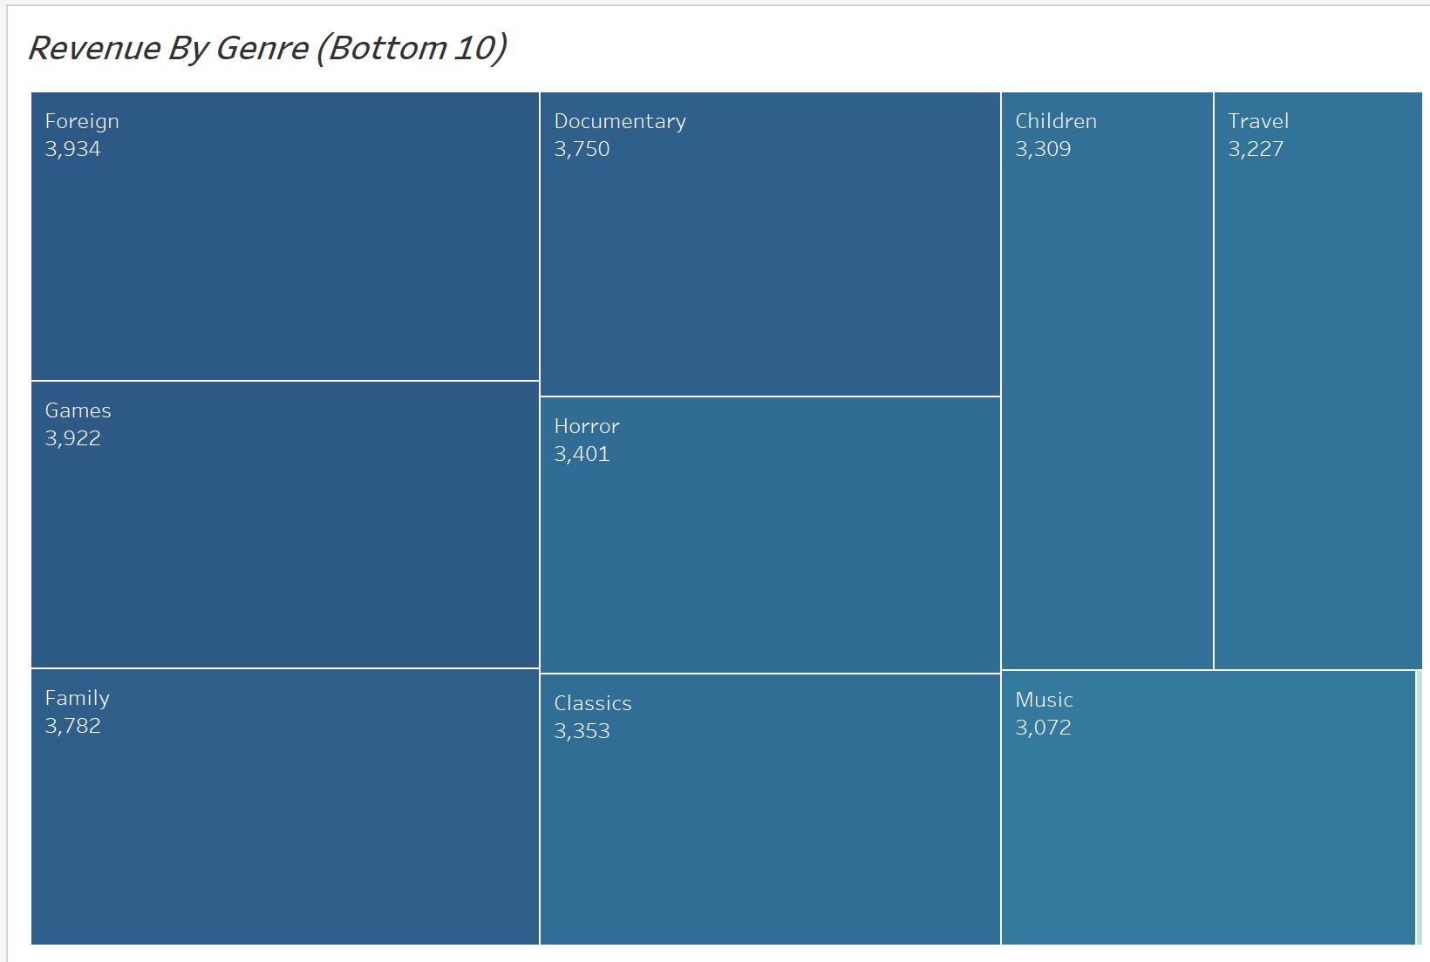
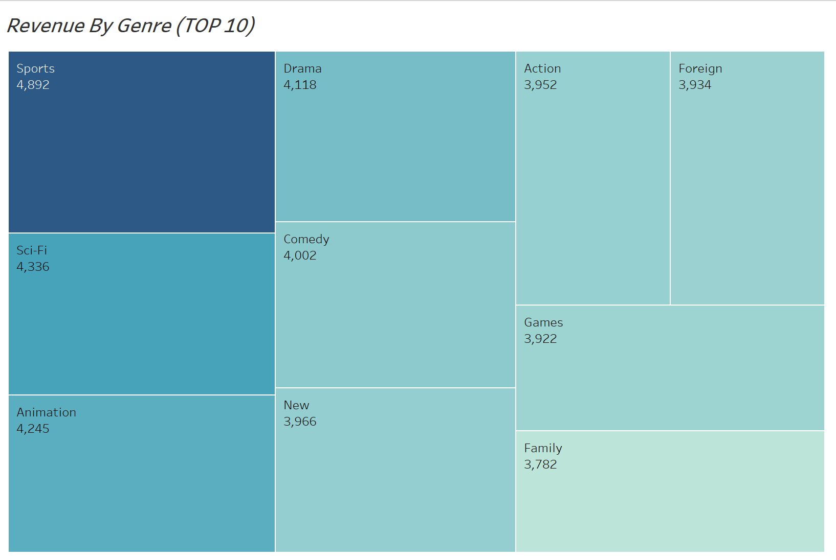
Revenue By Genre
This graph represents the total revenue from each genre and also shows the top 10 genre that generated the highest revenue so far versus the least 10 genre.

Slide 8
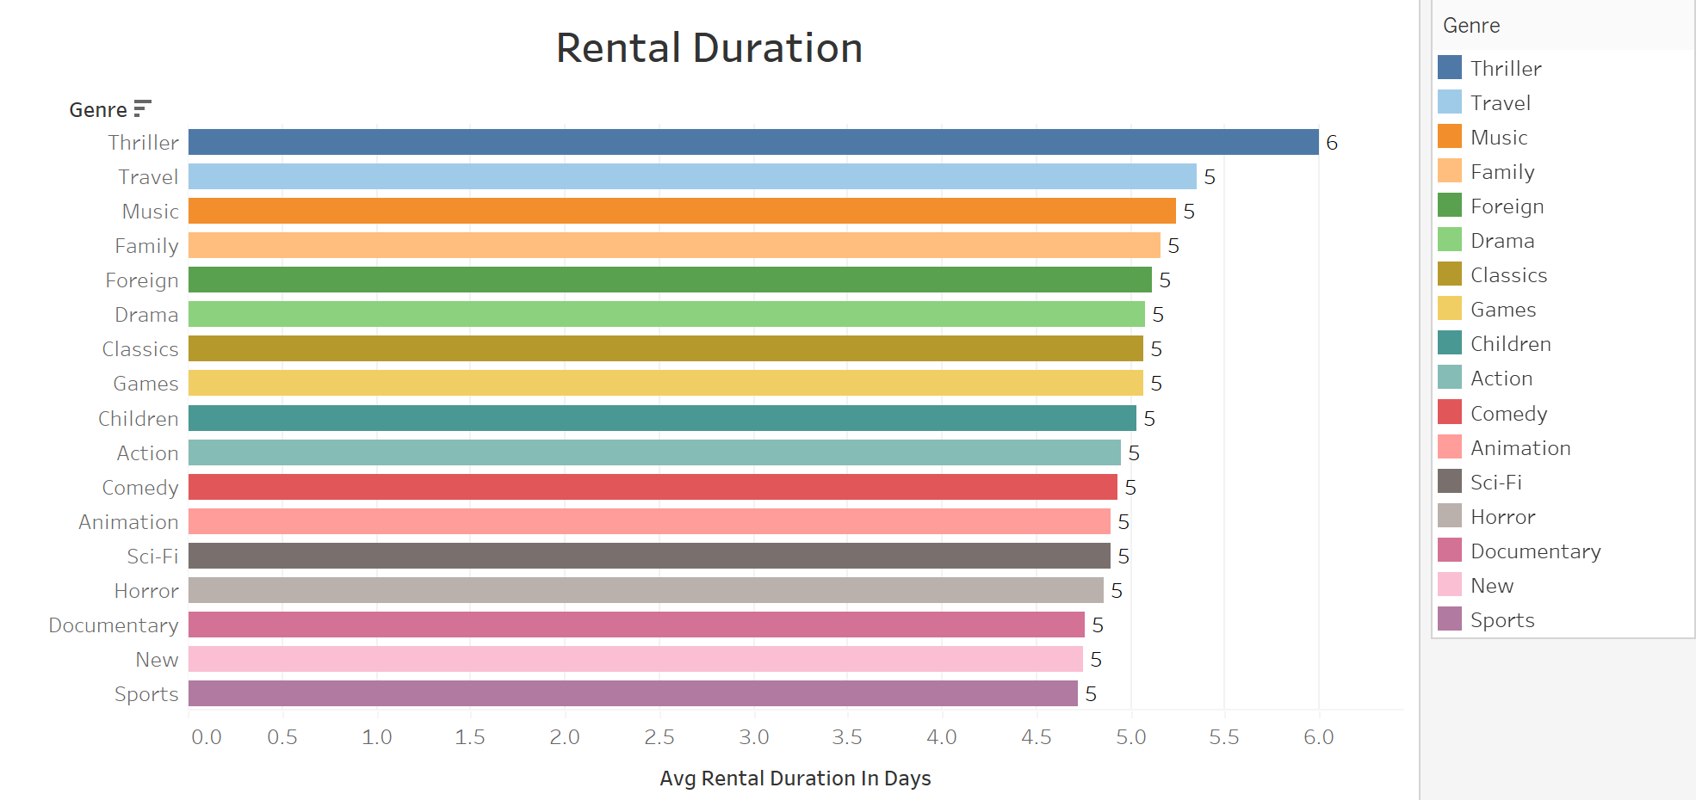
Rental Duration
Thriller, travel, music, family and foreign genres leads when it comes to average rental duration for films within all genres with an average of 5-6 days.
While Sports, new, documentary, horror and sci-fi have the least average rental duration with an average rental duration of 4 days.
Although, genre with high average rental duration does not translate into such genre having high revenue than those not within the high rental duration.

Slide 9
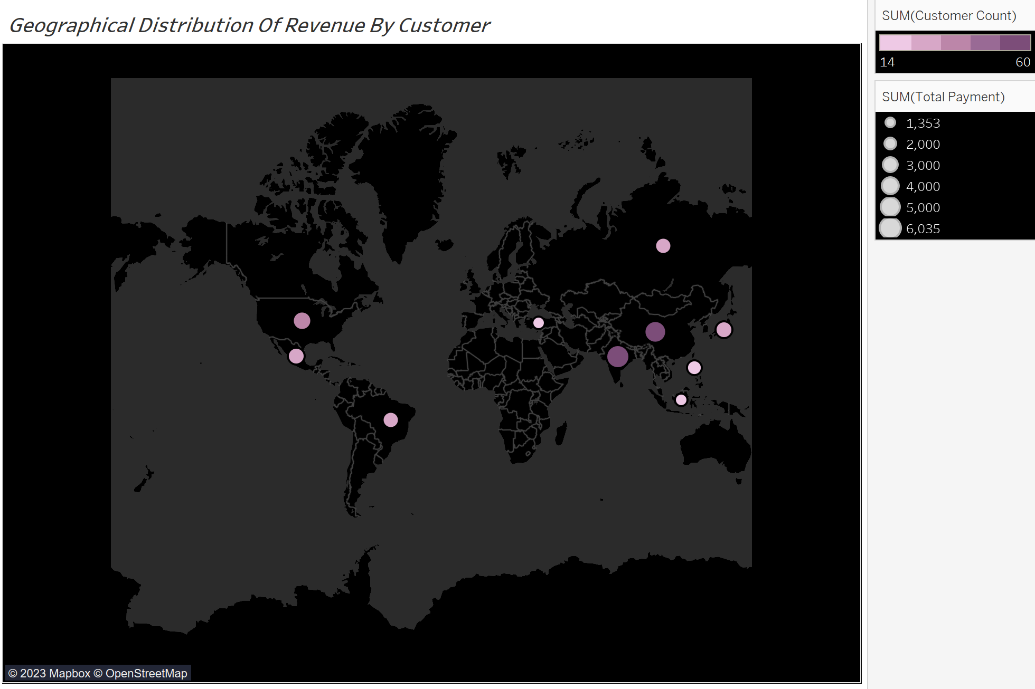
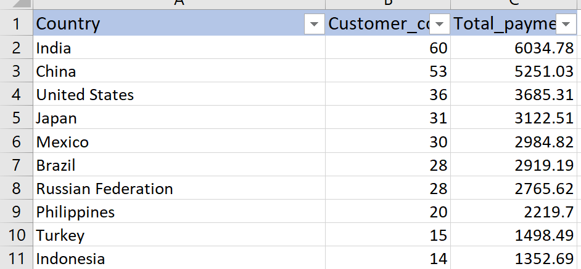
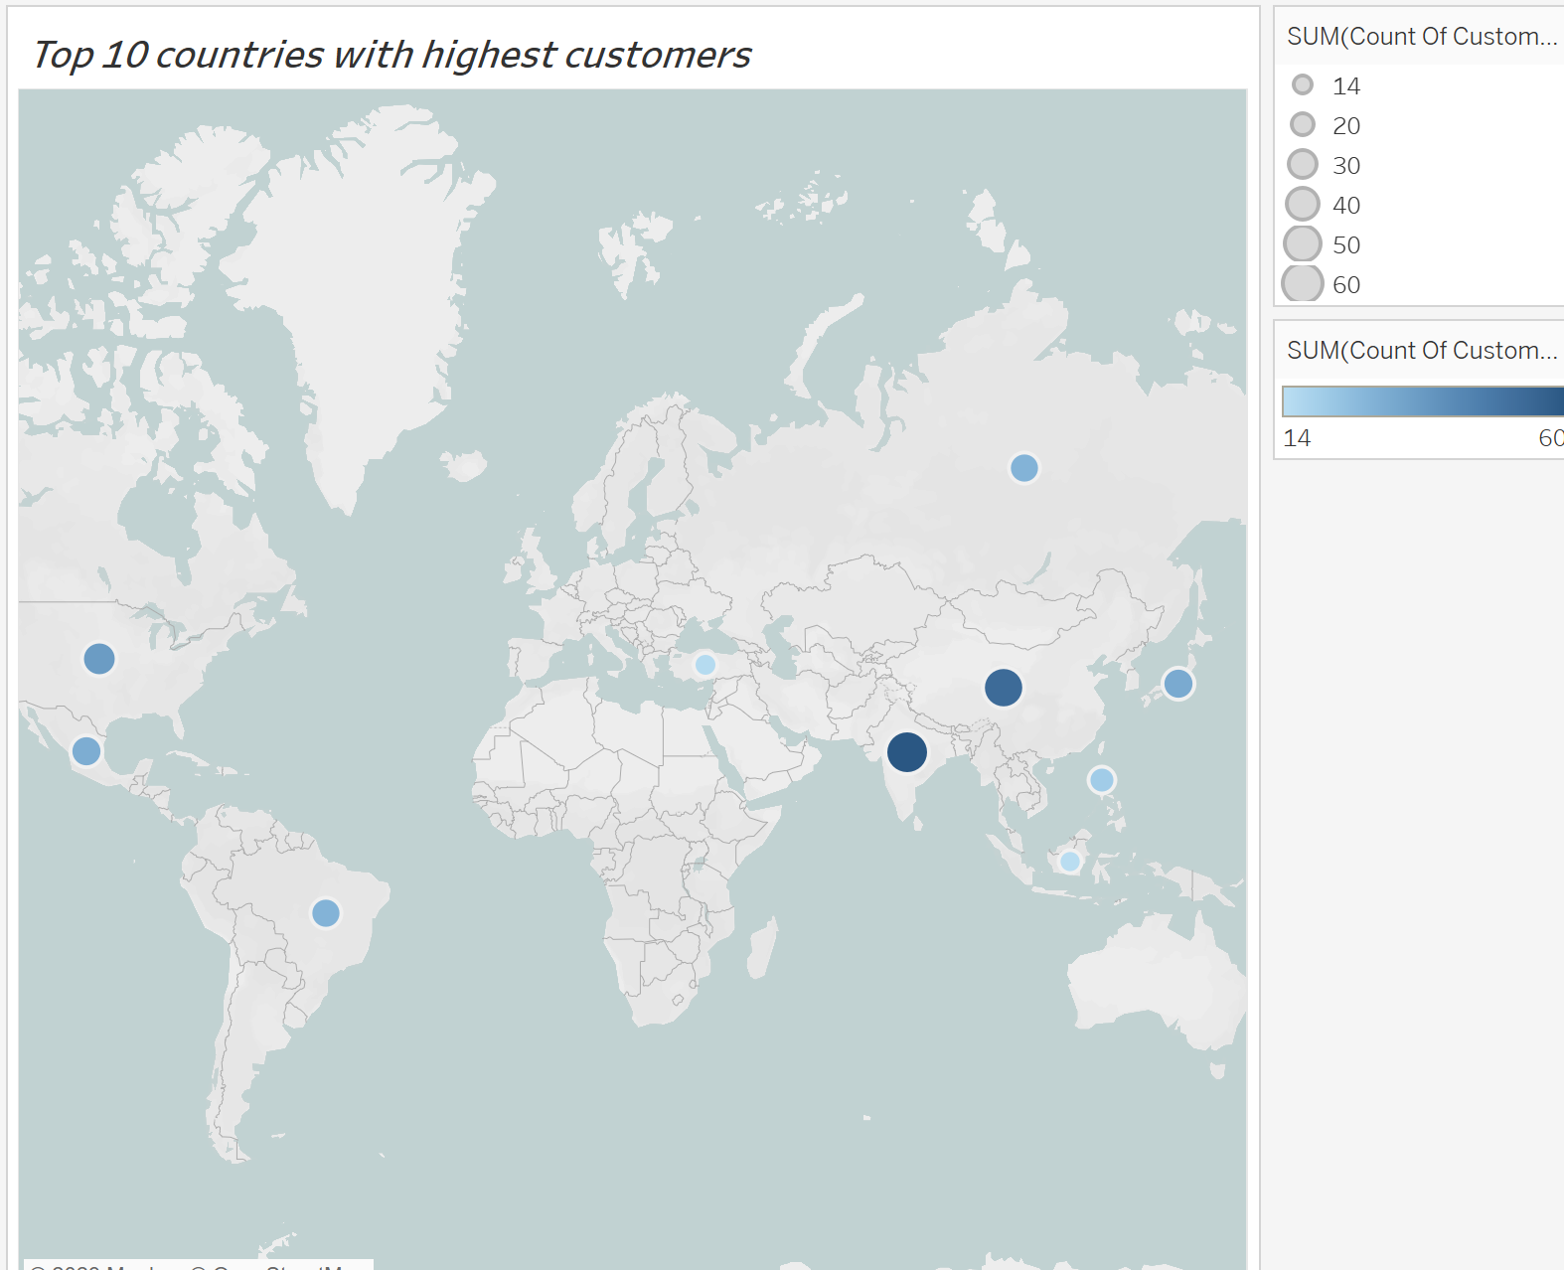
Countries With Highest Customers And Revenue

Slide 10

Recommendation
I suggest we stock more films with Genre that provides more revenue than that which have the highest rental duration.
I suggest further research into why our movies are not generating enough revenue in those Bottom 10 Countries.
Draw a feasibility plan to grow revenue in Europe, Australia and North America, maybe a rewards system for frequent renters or streamers and increase stocks across all ratings.
Babafemi
Babafemi.olayinka@gmail.com

Slide 11


Thank You
Babafemi.O

